Slide 1


Teamwork as a Core Professional Competency Presentation 1: Group Dynamics – An Overview
Professional Capabilities for a Digital World

Slide 2
Professional Capabilities for a Digital World
What we will be covering.
Evolution of the term ‘group dynamics’
Groups and Teams
Roles within groups
Roles aligning to an organisation’s mission and vision
Guidelines for focusing on & troubleshooting group work
Psychometric testing
Myers-Briggs Indicator Type (MBTI)
Being a new group but thinking like a long-term established group

Slide 3
Professional Capabilities for a Digital World
Objectives of this session.
Understand the concept of group dynamics
Comprehend the difference between teams and groups
Identify & understand the types of roles within groups
Comprehend the link between roles and vision
Understand how groups perform through cohesion & collaboration
Compare your experience with characteristics of high performing vs. dysfunctional groups
Understand the role of psychometrics as a possible indicator of group dynamics
Be more knowledgeable leaving than arriving for the session

Slide 4
ULOs focused on in this session
This week’s learning material will directly relate/focus on ULOs: 1,3 & 4
1. Develop and present a resolved project outcome which synthesises an understanding of ethical and socio-technical challenges faced by an ICT professional
2. Evaluate the role of standards, codes of conduct and legislative/regulatory obligations on the level of professionalism of the ICT industry
3. Review the roles and responsibilities of ICT professionals in organisations and society from a range of perspectives such as work-life balance, mentoring and life-long learning
4. Communicate effectively as a professional and function as an effective leader or member of a team

Slide 5
DERIVATION & DEFINITION OF THE TERM GROUP DYNAMICS
Dynamics is taken from the Greek word meaning ‘force’
The phrase ‘group dynamics’ refers to the forces operating within those groups
The processes, operations, and changes that occur within social groups, which affect patterns of affiliation, communication, conflict, conformity, decision making, influence, leadership, norm formation, and power.
Intergroup Dynamics
The processes that influence the shifting relationships between groups, including intergroup stereotyping, competition, conflict, and ingroup bias.
Notes:
Deals with the attitudes and behavioural patterns of a group,
Looks at how groups form,
What structures emerge and,
How they function.
Group dynamics deals with the attitudes and behavioural patterns of a group.
Group dynamics concern how groups are formed, what is their structure and which processes are followed in their functioning.
Thus, it is concerned with the interactions and forces operating between groups.
Group dynamics is relevant to groups of all kinds – both formal and informal.

Slide 6
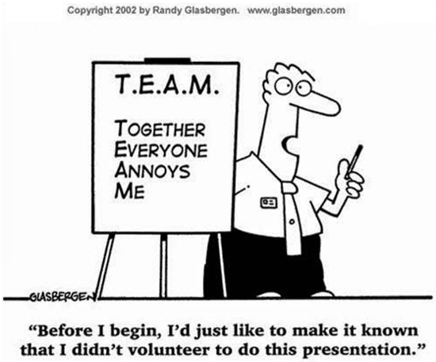
GROUP DYNAMICS / SETTING THE SCENE

Slide 7
WHAT IS A GROUP?.
Interaction – groups create and sustain relationships and task interactions
Goals – groups have goals & help members achieve outcomes
Interdependence – group members influence and are influenced
Structure – groups are organised
Cohesion – groups have cohesive social arrangements
.
.
IN
.
.
.
OUT
.
.
.
.
Group
Unified, consistent, solid, interconnected, interrelated
.
.
.
.
We define a group as two or more individuals that are connected by and within social relationships.
.
.
Notes:
What is a Group?
Interaction – groups create and sustain relationships and task interactions
Goals – groups have goals & help members achieve outcomes
Interdependence – group members influence and are influenced
Structure – groups are organised
Cohesion – groups have cohesive social arrangement
Every organization is a group unto itself. A group refers to two or more people who share a common meaning and evaluation of themselves and come together to achieve common goals. In other words, a group is a collection of people who interact with one another; accept rights and obligations as members and who share a common identity
Regardless of the size or the purpose, every group has similar characteristics:
(a) 2 or more persons (if it is one person, it is not a group)
(b) Formal social structure (the rules of the game are defined)
(c) Common fate (they will swim together)
(d) Common goals (the destiny is the same and emotionally connected)
(e) Face-to-face interaction (they will talk with each other)
(f) Interdependence (each one is complimentary to the other)
(g) Self-definition as group members (what one is who belongs to the group)
(h) Recognition by others (yes, you belong to the group).

Slide 8
DIFFERENCE BETWEEN GROUPS AND TEAMS / LITERATURE
The terms ‘group’ and ‘team’ are often used interchangeably
Differences are subtle
A team is a sub-set of groups
Teams have greater structure, and they have specific goals
Teams are a “small number of people with complementary skills who are committed to a common purpose, performance goals, and approach for which they hold themselves mutually accountable” (Katzenback & Smith’s HBR article, The Discipline of Teams)
A working group discusses, decides, and delegates
Whereas a team discusses, decides, and does real work together

Slide 9
Why do we study group dynamics?
Managing group dynamics = good management practice
Kurt Lewin coined the term ‘group dynamics’ in the 1940’s (Lewin, 1947).
People often take on distinct roles and behaviours in groups
Group dynamics describes these roles and behaviours
Team-based work structures
Building blocks of organisations
Need for diverse skills, expertise & experience
(What diverse kills, expertise & experience do you bring to the table?)
Some sociologists doubt whether the individual possesses significance when considered apart from the social groups of which they are a member. It is close social ties that give individual lives significance (Bruhn, 2009).
Notes:
Kurt LEWIN founder of social psychology. Born in Poland, Left Berlin when Hitler rose to power in 1933. UK and then emigrated to US and became a citizen.
He also proposed Herbert Blumer's interactionist perspective of 1937 as an alternative to the nature versus nurture debate. Lewin suggested that neither nature (inborn tendencies) nor nurture (how experiences in life shape individuals) alone can account for individuals' behavior and personalities.

Slide 10
ROLES WITHIN GROUPS
Roles are "sets of behaviours that are characteristic of persons in a particular social context” (Forsyth, 1999, p. 124) and "form part of our self-definition within the group, our sense of who we are" (Brown, 2000, p. 72).
As such, roles imply a certain division of labor among group members (Brown, 2000).
Even when there are no formal roles assigned within a group, informal roles do tend to emerge over time as members perform specific actions or functions (Forsyth, 1999).

Slide 11
ROLES WITH GROUPS /2
Task Orientated Roles
Initiator/Contributor
Information seeker
Information giver
Opinion seeker
Elaborator
Coordinator
Orienteer
Energiser
Critic
Recorder
Relationship Roles
Encourager
Harmoniser
Compromiser
Gate keeper
Standard setter
Group observer
Follower

Slide 12
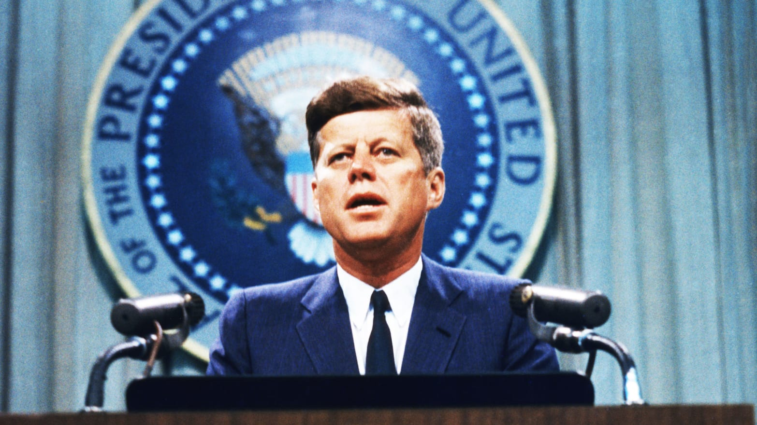

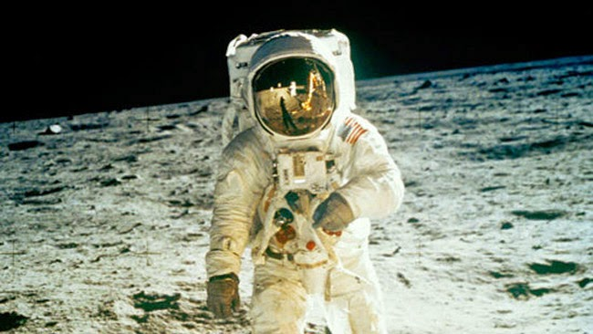

ROLES & THE IMPORTANCE OF UNDERSTANDING
THE MISSION & VISION
“What do you do?”
“I’m helping put man on the moon”

Slide 13
Understanding the Importance of effective teams
Cohesiveness:
Openness – Team members need to be willing to get to know each other and open up about themselves, so they realise that they all have diverse backgrounds and interests. This helps them to be more open to new ideas and differing viewpoints.
Trust – Team members need to trust each other enough to be comfortable with sharing ideas and feelings. As this trust builds, team members learn to be honest and respectful in their approach to each other.
Respect – It is important for the team not to focus on who to blame when something goes wrong, instead they need to work out how to fix it and how to learn from the mistake. Constructive feedback and mutual respect rather than blame will help a team achieve results much faster.

Slide 14
GUIDELINES FOR FOCUSING ON & TROUBLESHOOTING GROUP WORK
Increased productivity and performance
Skills development
Knowing more about yourself
Unfair division or take-up of labour between different group members
Conflict between different group members
Tackling inappropriate tasks as a whole group
Be aware of the limitations of group activity and don't be afraid to delegate responsibility for particular tasks to individuals

Slide 15
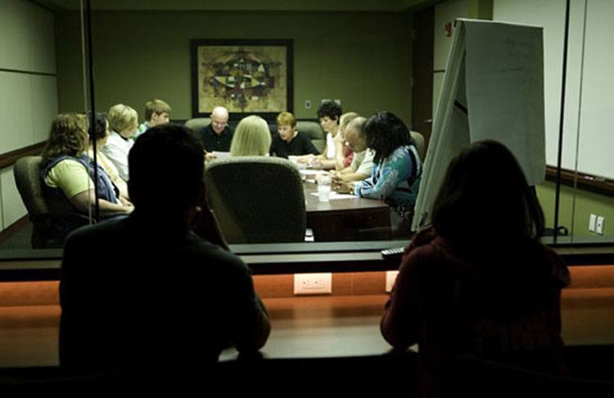
PSYCHOMETRIC TESTING
Psychometric tests include personality profiles, reasoning tests, motivation questionnaires, and ability assessments.
An increasing number of firms use psychometric tests to gather vital information from potential and current employees.
They are using psychometric (personality) tests for:
Graduate recruitment
Building and developing teams

Slide 16
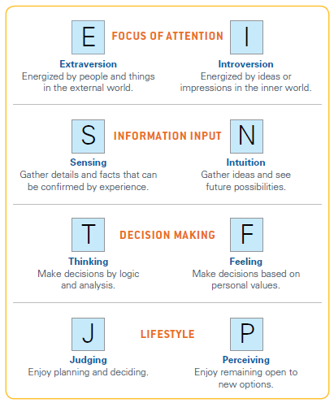
PSYCHOMETRIC TESTING /
MYERS-BRIGGS TYPE INDICATOR® (MBTI)
A questionnaire designed to make psychological types understandable and useful in our everyday lives.
MBTI results identify valuable differences between people – differences that can be the source of misunderstanding and miscommunication.
Eight personality type preferences:
Extraversion vs Introversion
Sensing vs iNtuition
Thinking vs Feeling
Judgment vs Perception

Slide 17
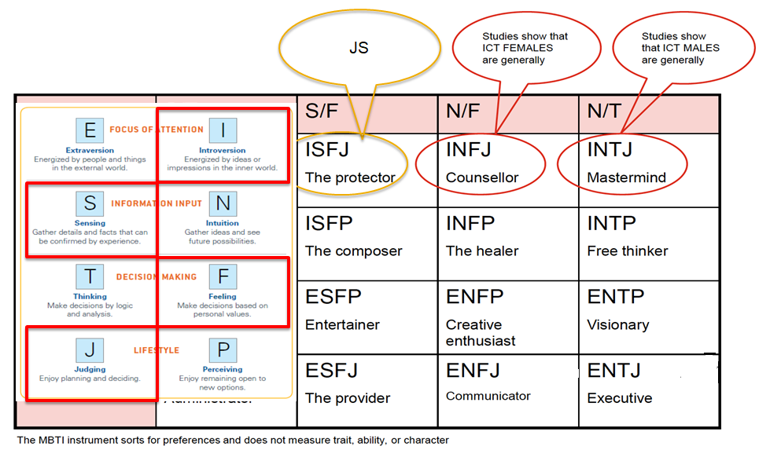
YOUR CONVENOR’S, FEMALE STUDENTS & MALE STUDENTS / MYERS-BRIGGS TYPE INDICATOR® (MBTI)

Slide 18
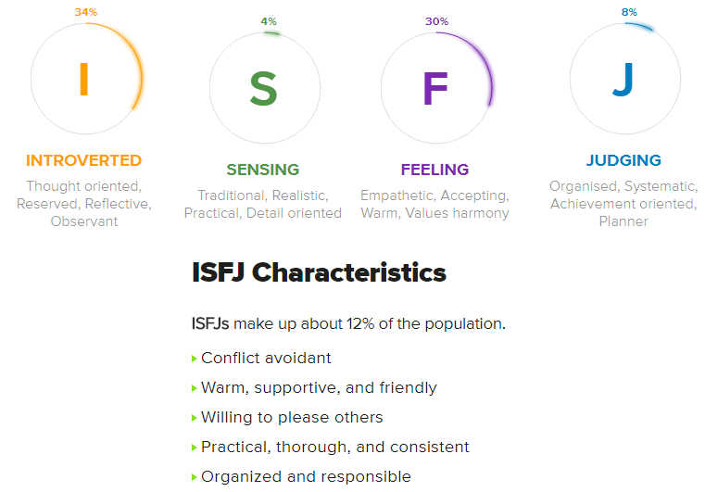
YOUR CONVENOR’S,
/ MYERS-BRIGGS TYPE INDICATOR® (MBTI)

Slide 19
BEING A NEW GROUP BUT THINKING LIKE A
LONG-TERM ESTABLISHED GROUP IS THE TRICK.
New groups tend to have a lower sense of trust in and attraction to the group
Members of new groups tend to exhibit little identification with the group or its goals and are motivated primarily by self-interest
Members of long-term groups exhibit high levels of identification with the group and its goals and are mutually supportive.
Members of new groups tend to base their perceptions of the abilities and skills of others on stereotypes
Members of long-term groups have a higher level of awareness of the actual skills and abilities of their team-mates
Communication, focus areas of agreements, conflict resolution and combining of resources are also important consideration to think like a long-term team in a short amount of time.

Slide 20
HAVE WE MET OUR OBJECTIVES
Understood the concept of group dynamics
Comprehended the difference between teams and groups
Identified & understood the types of roles within groups
Comprehended the link between roles and vision
Understood how groups perform through cohesion & collaboration
Compared your experience with characteristics of high performing vs. dysfunctional groups
Understood the role of psychometrics as a possible indicator of group dynamics

Slide 21


